Slide 1
Real Time Actions with Configuration Manager
Jonathan Warnken

Slide 2
What are the real time\fast channel actions?
Client Notifications
Endpoint Protection actions
Run Scripts
CMPivot
Notes:
The client notifications aka “fast channel” communications were added in SCCM 2012 R1 (https://techcommunity.microsoft.com/t5/Configuration-Manager-Archive/Fast-Channel-for-System-Management-Client-Notification-in-System/ba-p/273157) and keep improving with each update.
Client Notifications – Think of this as the item you can trigger via the configuration manager control panel. This list is not one for one but keeps improving over time.
Endpoint Protection actions – Full Scan, Quick Scan, Download Definitions
Run Scripts – Powershell scripts that you create and approve to be executed in your environment.
CMPivot – Read only queries using data collected from online systems, offline systems will report data from last inventory if available.
These all work over CMG for internet based clients.

Slide 3
How fast channel works
When the client (ccmexec.exe) starts it establishes a persistent TCP connection to the Management Point. If the TCP connection fails it falls back to HTTP(s).
The Notification Server on the Management Point manages all active connections and updates the online status data every 5 minutes.
This is the source of the client icon status.
When a notification is sent to a client the Management Point pushes the notification to the client. The client will report the status of the action back to the Management Point.
The Management Point will throttle the requests (Default is 42 clients each second)
The notification will be tried for 1 hour
Notes:
Throttling controlled via registry HKEY_LOCAL_MACHINE\SOFTWARE\Microsoft\SMS\NotificationServer Task Throttle Param

Slide 4
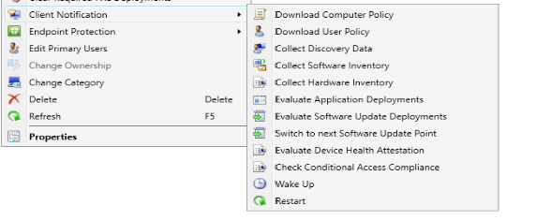
Client Notifications
Notes:
1906 Client Notification list
In version 1806 or earlier, the Client Notification option is only available from either the Device Collection node or when you viewed the membership of a Device Collection. Starting in version 1810, you can start a Client Notification directly from the Devices node. There's no longer a requirement to be within a collection membership view.
Permissions
Starting in version 1810, client notification actions now require the Notify Resource permission on the Collection object. This permission applies to all actions under the Client notification menu.
The following built-in roles have this permission by default:
Full Administrator
Infrastructure Administrator
Add this permission to any custom roles that need to use client notification actions.

Slide 5

Endpoint Protection actions
Notes:
Permissions
This action requires the Enforce Security permission on the Collection object.
The following built-in roles have this permission by default:
Full Administrator
Endpoint Protection Manager
Operations Administrator
Add this permission to any custom roles that need to trigger Endpoint Protection actions.
Full Scan
Trigger Endpoint Protection or Windows Defender to run a full antimalware scan.
Quick Scan
Trigger Endpoint Protection or Windows Defender to run a quick antimalware scan.
Download Definition
Trigger Endpoint Protection or Windows Defender to download the latest antimalware definitions.

Slide 6
Run Scripts
Powerful and customizable feature
Scripts execute in the local system context. Which by default means no network access.
Scripts are downloaded and executed on the client from ccm\scriptstore
Parameters are passed to the clients as Base64 encoded strings
- This is obfuscation not encryption.
- As a security best practice do not store secrets in scripts. (This includes passing passwords as a parameter!)
Notes:
Prerequisites
To run PowerShell scripts, the client must be running PowerShell version 3.0 or later. However, if a script you run contains functionality from a later version of PowerShell, the client on which you run the script must be running that version of PowerShell.
Configuration Manager clients must be running the client from the 1706 release, or later in order to run scripts.
To use scripts, you must be a member of the appropriate Configuration Manager security role.
To import and author scripts - Your account must have Create permissions for SMS Scripts.
To approve or deny scripts - Your account must have Approve permissions for SMS Scripts.
To run scripts - Your account must have Run Script permissions for Collections.
Security products that block the execution of powershell scripts from ccm\scriptstore will stop the scripts from running.
Added in 1706 as prerelease feature. 1802 no longer prerelease.
Not enabled by default.
Parameters added in 1710
Edit and Copy scripts added on 1902

Slide 7
CMPivot
Realtime query
All queries are read only
Scalable
Notes:
Scalability for the biggest query (high water mark), 1K. - Let’s say that you have a SCCM collection that have 50,000 endpoints, that is ~50MB max over the network.

Slide 8
Demo

Slide 9
Questions ???

